Slide 1





JVM的那点事
AndyHoo

Slide 2

类加载
类加载器，双亲委派机制,自定义类加载器，破坏双亲委托机制
OOM
堆,栈,方法区,程序计数器，本地方法栈, client，server模式
JVM
GC
GC roots,GC分类,GC设置参数
jvm&synchronized
堆中的对象，对象头，monitor，synchronized

Slide 3


类加载
五个阶段
1.loading ---> 2.Verification ---> 3.Preparation --->4.Resolution--->5.Initialization

Slide 4

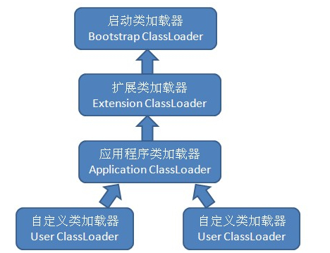




根类加载器 Bootstrap class loader
Class Loader
扩展加载器 Extension class loader
系统应用加载器 App class loader
用户自定义加载器 Customer class loader

Slide 5






类加载过程:
findLoadedClass(name)判断当前类是否已加载
否
双亲委托机制
初始化为系统类加载器
判断类加载器是否存在父类加载器
存在就交给父类加载
不存在就直接交给根类加载器
根类加载器无法加载的,自己尝试加载

Slide 6


public abstract class ClassLoader {
//...
//默认的类加载器为systemClassLoader
protected ClassLoader() {
SecurityManager security = System.getSecurityManager();
if (security != null) {
security.checkCreateClassLoader();
}
this.parent = getSystemClassLoader();
initialized = true;
}
public Class<?> loadClass(String name) throws ClassNotFoundException {
return loadClass(name, false);
}
protected Class<?> loadClass(String name, boolean resolve)
throws ClassNotFoundException
{
//对需要加载的class上锁
synchronized (getClassLoadingLock(name)) {
// First, check if the class has already been loaded
Class<?> c = findLoadedClass(name);
if (c == null) {
long t0 = System.nanoTime();
try {
if (parent != null) {
//如果存在父类加载器，交给父类加载器
c = parent.loadClass(name, false);
} else {
//如果不存在父类(根类无法被java调用)直接调用根类加载器
c = findBootstrapClassOrNull(name);
}
} catch (ClassNotFoundException e) {
// ClassNotFoundException thrown if class not found
// from the non-null parent class loader
}
if (c == null) {
// If still not found, then invoke findClass in order
// to find the class.
long t1 = System.nanoTime();
c = findClass(name);
// this is the defining class loader; record the stats
sun.misc.PerfCounter.getParentDelegationTime().addTime(t1 - t0);
sun.misc.PerfCounter.getFindClassTime().addElapsedTimeFrom(t1);
sun.misc.PerfCounter.getFindClasses().increment();
}
}
if (resolve) {
resolveClass(c);
}
return c;
}
}
少啰嗦，直接看代码

Slide 7


自定义类加载器
实现ClassLoader抽象类ClassLoader,重写findClass方法即可。
/**
* 获取字节码文件的二进制数据
* @author hudaqiang
* @date 2019/6/29 13:01
*/
private byte[] getClassBytes(String className) {
String path = getClassPath(className);
try {
InputStream ins = new FileInputStream(path);
ByteArrayOutputStream baos = new ByteArrayOutputStream();
int bufSize = 2048;
byte[] byteBuf = new byte[bufSize];
int bytesNumRead = 0;
// 读取类文件的字节码
while ((bytesNumRead = ins.read(byteBuf)) != -1) {
baos.write(byteBuf, 0, bytesNumRead);
}
return baos.toByteArray();
} catch (IOException e) {
e.printStackTrace();
}
return null;
}
/**
* 根据类名获取字节码文件的路径
* @author hudaqiang
* @date 2019/6/29 13:02
*/
private String getClassPath(String className) {
return className.replace('.', File.separatorChar) + ".class";
}
package com.andy.classloader;
import lombok.Data;
import java.io.*;
/**
* @Description 自定义类加载器
* @className CustomClassLoader
* @author hudaqiang
* @date 2019/6/29 13:08
*/
@Data
public class CustomClassLoader extends ClassLoader {
@Override
protected Class<?> findClass(String name) throws ClassNotFoundException {
byte[] classData = getClassBytes(name);
if (classData == null) {
throw new ClassNotFoundException();
} else {
return defineClass(name, classData, 0, classData.length);
}
}

Slide 8

SPI
01.
JNDI,JDBC,JCE,JAXB和JBI,解决双亲委派机制中类加载请求的单向委派。
Thread Context ClassLoader
02.
框架的代码为了加载框架之外的用户实现代码
OSGi
03.
tomcat,Open Service Gateway Initiative
破
坏
双
亲
委
托机制

Slide 9
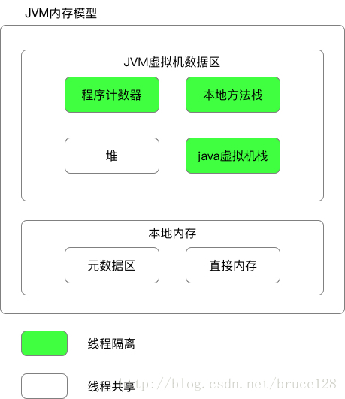
OOM
程序计数器: 1.标记线程正在执行的字节码行号
2.线程隔离
3.线程执行native方法时值为null
方法区: 1.jdk 1.8以前使用永久代实现，1.8以后使用 直接内存中的元空间实现;
2.线程共享
3.放虚拟机加载的类信息(版本,字段，方法， 接口)，静态属性，常量；
Heap(堆): 存放对象信息
虚拟机栈: 方法执行的内存模型

Slide 10

商务介绍
商务介绍
商务介绍
1.
2.
3.
A guest with a web page version of the iPhone
A guest with a web page version of the iPhone
A guest with a web page version of the iPhone
商务介绍
商务介绍
商务介绍
4.
5.
6.
A guest with a web page version of the iPhone
A guest with a web page version of the iPhone
A guest with a web page version of the iPhone

Slide 11




项目介绍​
项目介绍​
项目介绍​
A guest with a web page version of the iPhone A guest with a web page version
A guest with a web page version of the iPhone A guest with a web page version
A guest with a web page version of the iPhone A guest with a web page version
568K
23.5%
10/8

Slide 12



2020
我们的业务品质​
A guest with a web page version of the iPhone device A guest with a web page A guest with a web
pageA guest with a web page version of the iPhone device

Slide 13
PART.THREE
项目汇报
A guest with a web page version of the iPhone device A guest with a web page A guest with a web page version
of the iPhone device A guest with a web page

Slide 14




+86%
我们的市场占比
A guest with a web page version of the iPhone device A guest with a web page A guest with a web
pageA guest with a web page version of the iPhone device
MORE

Slide 15



Business introduction
A guest with a web page version of the iPhone device A guest with a web page A guest with a web page version
of the iPhone device A guest with a web page
商务介绍

Slide 16
PART.FOUR
未来规划
A guest with a web page version of the iPhone device A guest with a web page A guest with a web page version
of the iPhone device A guest with a web page

Slide 17


商务介绍
商务介绍
A guest with a web page version of the iPhone device A guest with a web page A guest with a
A guest with a web page version of the iPhone device A guest with a web page A guest with a
商务介绍
商务介绍
A guest with a web page version of the iPhone device A guest with a web page A guest with a
A guest with a web page version of the iPhone device A guest with a web page A guest with a

Slide 18
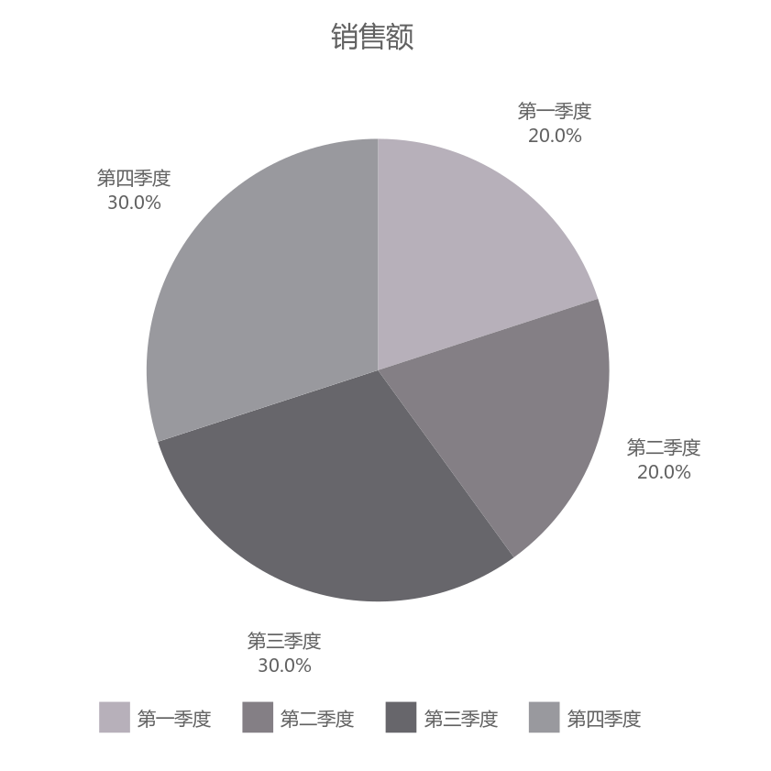
+86%
我们的市场占比
A guest with a web page version of the iPhone device A guest with a web page A guest with a web
pageA guest with a web page version of the iPhone device
MORE

Slide 19
THANK YOU
BUSINESS POWERPOINT
END

